Slide 1
Stress & Coping 1

Slide 2
What is stress?
Many lay definitions of stress
  E.g. Pressure, tension, emotional response
Research definitions:
  Stressor: external environment
  Stress or distress: response to stressor
  Eustress: positive or beneficial stress
  Acute stress: short term
  Chronic stress: ongoing and longer term

Slide 3
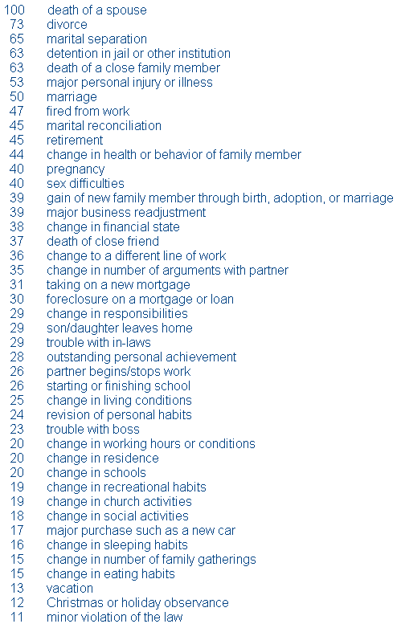
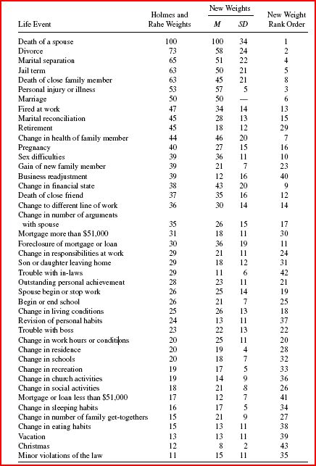
What is stress?
A stimulus approach
  Something happens in the environment (stressor) to provoke a stress reaction
  Intuitive, useful:
    I lost my job, she insulted me etc
  Daily Hassles
  Life Events Theory
    unweighted
  Social Readjustment Rating Scale
    Weighted
    1967 - https://www.sciencedirect.com/science/article/pii/0022399967900104?via%3Dihub
    Updated weightings Scully et al., (2000) - https://journals.sagepub.com/doi/pdf/10.1177/00131640021970952

Slide 4
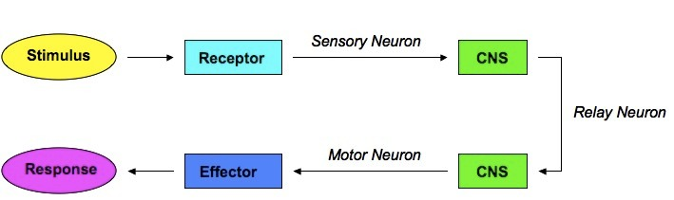
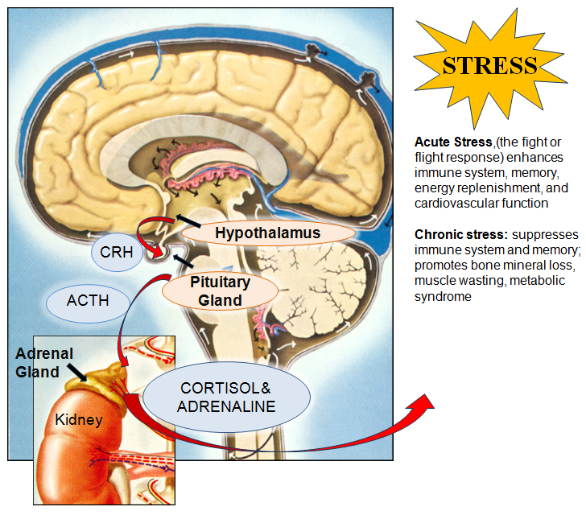
Issues
Stimulus centred approaches S-R in nature… apparent failure to consider individual and developmental differences
  Initially didn’t have importance/weighting component
  Retrospective – bias towards negative events or bias towards biological or psychosocial events
  Not necessarily independent
  Acute vs chronic
    Many in SRRS are relatively rare – we’ll consider daily hassles later
  Link to health?

Slide 5
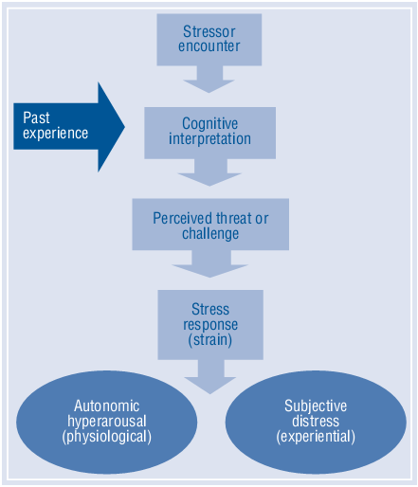
Response Approach
A response, focusing on reaction to stressors
  Psychological components of behaviour, thought patterns and emotions
  Physiological component of heightened bodily arousal
  Psychological + physiological responses = strain
Circular though, stressor defined by stress response, stress response defined by stressor…

Slide 6
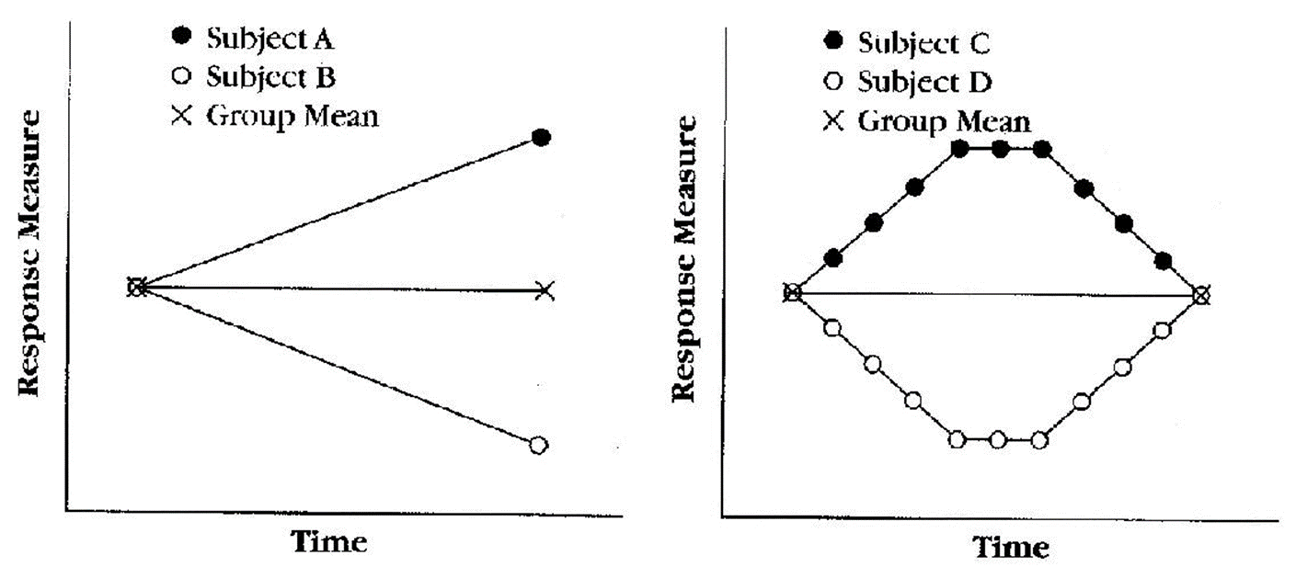
Individual differences
Many areas of psychology seem ambivalent (implicitly)
  General laws transcending context.
  With notable exceptions
  Noise, errors of measurement, variations around general laws…
Substantial individual differences in response to ‘stressors’
  Do we simply passively respond?
  Lazarus & Eriksen (1952) – threat of failure increased variability
  Is it useful to suggest that some events are statistically more likely to result in a stress reaction?

Slide 7
A transactional/relational approach (Lazarus et al various)
Dynamical person-environment interactions
The relative balance of environmental demands and psychological resources.
Environmental Demands
Psychological Resources
Nice Balance:
little or no stress
Environmental Demands
Psychological Resources
Low stress:
Boredom?
Psychological Resources
High stress
Environmental Demands

Slide 8
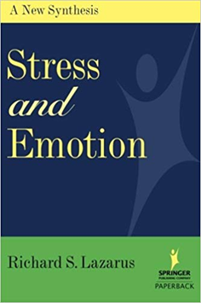
Cognitive Processes
The meaning constructed by a person is crucial in the stress reaction
  Experience – new experiences evaluated in the same way
Psychological meaning (personal significance) is the proximal cause of stress.
Distal causes are larger categories
  E.g., SES, ethnicity, sex, age
  More likely to be shared meaning, but not all men/women/Māori/Pakeha etc react in the same way.
  Need to know more about individuals

Slide 9
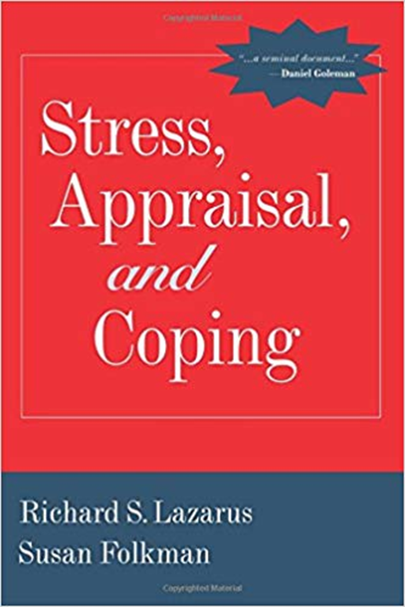
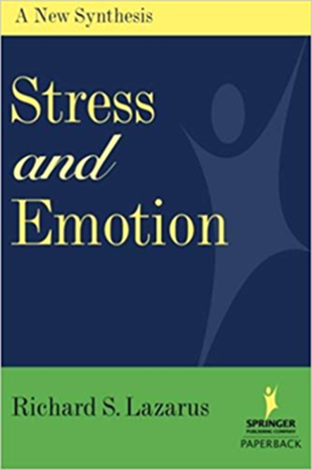
Cognitive Appraisal
Richard Lazarus (1922-2002) and colleagues
  notably Susan Folkman
  Highly recommend reading some of his books
  E.g., Stress, Appraisal and Coping; Stress and Emotion
Antecedents…
  Environmental Variables
    Demands – implicit and explicit pressures from the social environment (can be internalised)
    Constraints – define what you should not do
    Culture – Lazarus not convinced that this isn’t the above
    Opportunities – timing and choices
  Personal Variables
    Goals – no goal, no stress…
    Beliefs about self and world – our conception of ourselves in our environment – shapes expectations (behaviour?)
    Personal resources – influences what we can and cannot do to attain goals/gratification

Slide 10

Cognitive Appraisal
Lazarus
  In 1950’s became convinced that the main source of variation in the arousal of stress and its effects on functioning is the way an individual evaluates the personal significance of what is happening (the demand).
  The notion of appraisal (vs perception)
    Also, “stress occurs when a particular situation threatens the attainment of some goal” Lazarus et al., (1952)
Stressful or not...
    Irrelevant, neutral, positive
Two key factors to assess
  Whether the demand threatens wellbeing (primary)
  Your resources available to meet the demand (secondary)

Slide 11
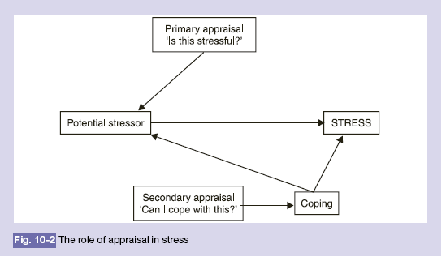
Appraising events as stressful
Primary Appraisal
  Harm-loss – amount of damage that has already occurred.
  Threat – expectation of future harm.
  Challenge – ability to benefit from a situation by using more than routine resources to meet demand.

Slide 12
Secondary Appraisal
Cognitive-evaluative process focussed on what can be done about the stressful situation.
Evaluation of coping options/assessment of resources
  Active searching for information and meaning on which to predicate action
  Action, gather information, do nothing, relaxation or defence mechanisms
Interrelated with primary appraisal
  e.g., evaluation of our resources may determine whether threat or challenge dominates
  Perhaps more aware of this…

Slide 13
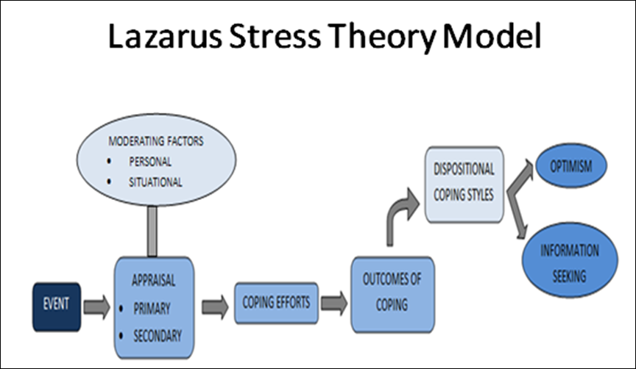

Slide 14
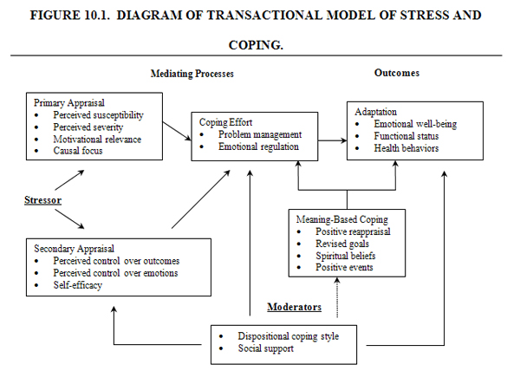

Slide 15
What events are appraised as stressful?
Salient events: personally relevant
  Family, friends, work etc
Overload: Multitasking
  Single stressor that adds to a background of other stressors often appraised as more stressful than when it occurs alone
Ambiguous events: unclear tasks
  Clearly defined → develop coping strategy... Ambiguous → time and energy comparing approaches, often no identifiable strategy to cope
Uncontrollable events: if task is not predicted
  Predicted and controllable events less stressful than random uncontrollable ones

Slide 16
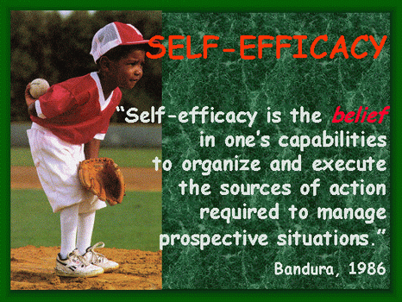
What factors influence appraisals?
Personal factors include intellectual, motivational and personality characteristics
  Self-efficacy – the confidence in one’s abilities to solve problems
  Motivation – perceived importance of a goal increases its stress
  Belief system – attitudes to encountering stress
  Hardiness – personal resilience to stress

Slide 17
What factors influence appraisals?
Environmental variables
  Familiarity, predictability, controllability and clarity favour challenge
  Ambiguity, imminence, poor timing and long duration tend to favour threat
  Of course environmental and personal variables interact…
    E.g., ambiguity, controllability

Slide 18
Psychological aspects of stress
Cognitive
  Stress can distract attention from other tasks, but also enhance attention toward the stressor
    Tuning out, remembering emotional events
  Stress can inhibit cognitive functioning, including short- and long-term memory and motivation
  Stress about an event can maintain thoughts about stressful events
  But, remember Lazarus & Eriksen (1952)

Slide 19
Psychological aspects of stress
Emotional
  Younger infants display stress by distress, older infants display anger
  Adults can also display anger in reaction to stress
  Cognitive appraisals assigned to stressful event determine emotional reaction
    Physiological rxn similar, use context
  Fear is a common response to stress – can also manifest as phobias and anxiety
  Stress can lead to depression

Slide 20
Psychological aspects of stress
Social behaviour
  Emergency situations can foster cooperation
  Stress can lead to hostility, insensitivity and social withdrawal
    E.g., serious illness
  Stress accompanied by anger can increase negative social behaviours
    E.g., relationship between parental stress and child abuse...
  Stress can decrease helping behaviours
    Difficult task → opportunity to help...

Slide 21
Measuring stress
Physiological arousal
  Polygraph – blood pressure, heart rate, respiration rate, galvanic skin response
  Hormonal secretion
    Corticosteroids – cortisol
    Catecholamines – epinephrine and norepinephrine
  Problems – stressful, need good baseline etc
Psychological symptoms
  Report of distress not perfectly correlated with physiological arousal
  Physiological and psychological stress can be independent, and need to both be accounted for in studies of stress
  Use of mood, anxiety, and psychiatric scales.
    What are we measuring, stress or mental illness?

Slide 22
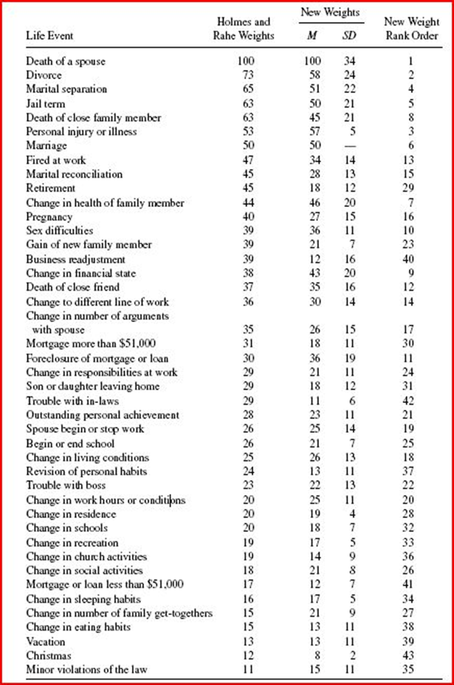
Measuring stress – life events
Social Readjustment Rating Scale (SRRS)
  List of events rated for degree of life change they demanded
  Weightings central – many of these events are rare, and of course incredibly stressful
  Think PNI – evolution has encountered these before… obviously many of them occurring in short time-frame is not good
  Stress to more frequent events?
  https://www.sciencedirect.com/science/article/pii/0022399967900104?via%3Dihub
  https://journals.sagepub.com/doi/pdf/10.1177/00131640021970952

Slide 23
Daily Hassles
One off events (acute) vs day-to-day unpleasant events
    Hassles scale and student hassles scale
Range of scales – early work by Lazarus, and Holm, and others in more recent years
  Started with 100+ items…
Frequent hassles
  Weight concerns
  Health of family member
  Sex
  Finance
  Home maintenance
  Time pressures
  Misplacing things

Slide 24
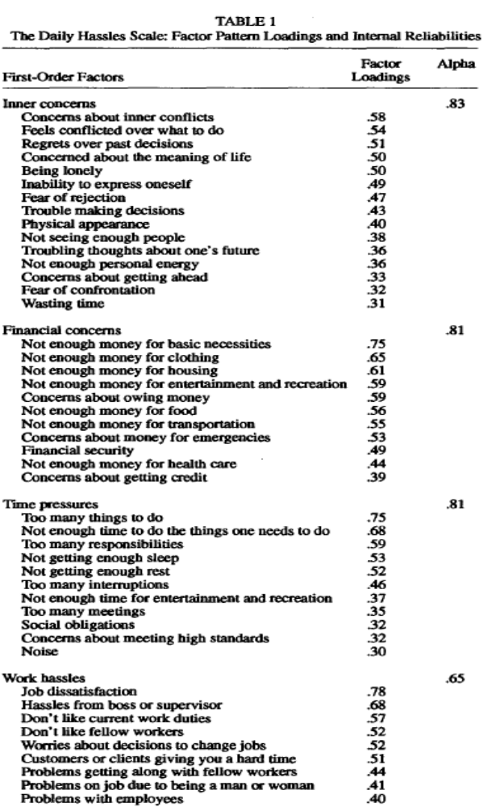
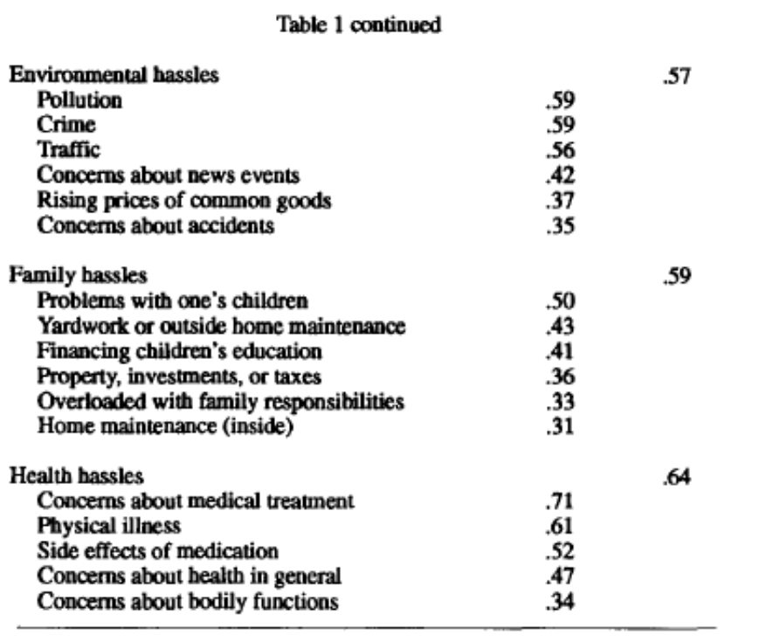
https://www.researchgate.net/profile/Ke_Holroyd/publication/232511477_The_Daily_Hassles_Scale_Revised_Does_it_measure_stress_or_symptoms/links/56f04ab808ae584badc930e6/The-Daily-Hassles-Scale-Revised-Does-it-measure-stress-or-symptoms.pdf

Slide 25
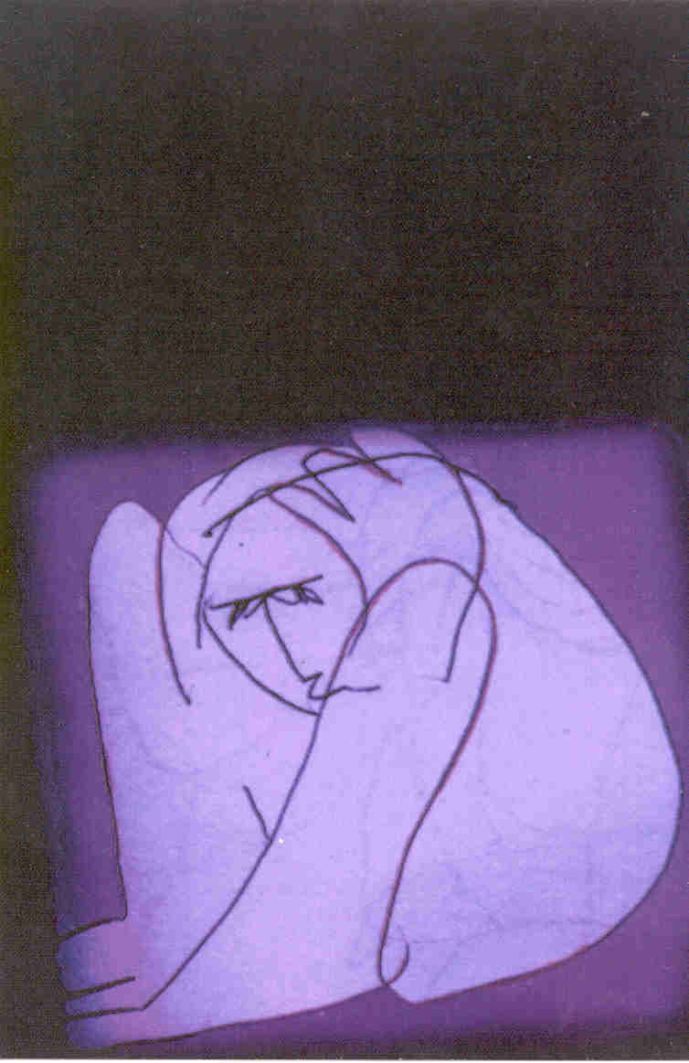
Strengths and weaknesses
  Strengths
    Representative of stressful events
      Part of design, usually
    Relatively quick and easy to complete
  Weaknesses
    Introspective self-report, people under stress tend to behave irrationally
    Some argue arbitrary, scatter-gun approach, and possibly measuring neuroticism
      ‘too many things to do’, ‘troubling thoughts about the future’
    Relate stress to illness – but correlation weak – approx 0.3
    People may interpret events differently, and the individual impact is not accounted for
    Not clear if some events are desirable or undesirable
      Or if individuals would view them the same way
      Threat vs challenge etc

Slide 26
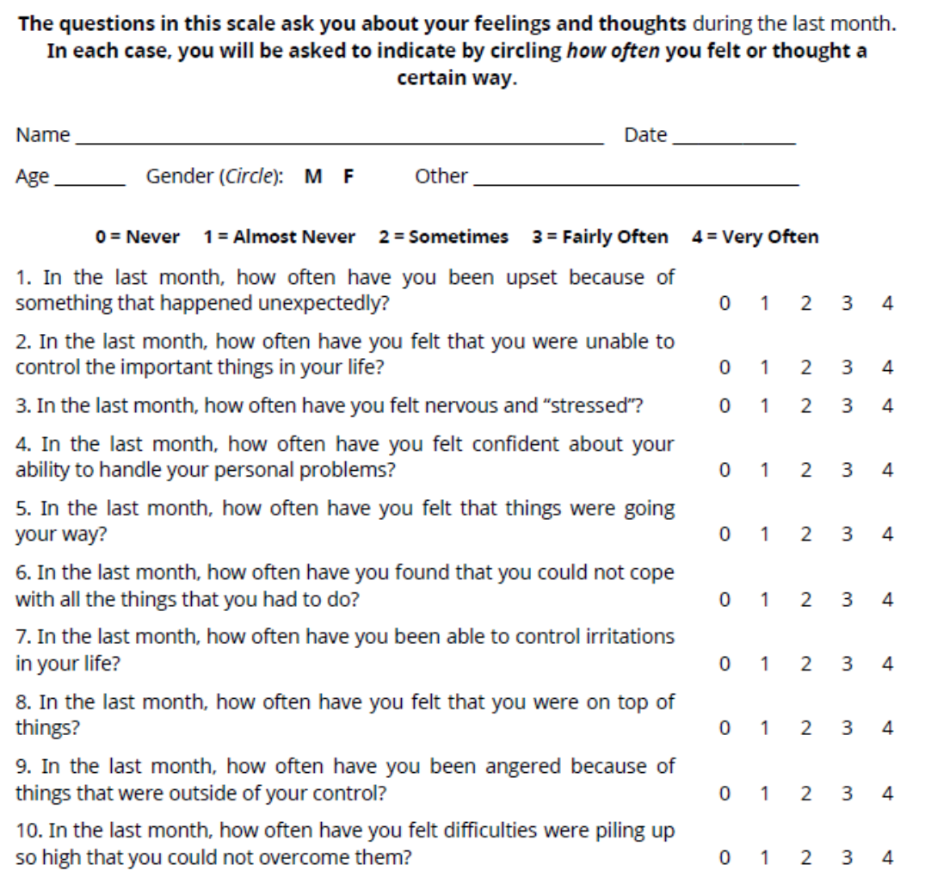
Measuring stress – perceived stress
We looked at this when discussing PNI – more ‘subjective’ approach
Avoids specific events, and focuses on response…
That’s not a problem – psychometrics good, and relates to outcomes (health)
http://www.mindgarden.com/documents/PerceivedStressScale.pdf

Slide 27
Coping: Denial
Good way to cope or bad?
  Heart attack…
  In hospital after attack
  Returning home
Perhaps when nothing can be done, denial is a reasonable approach?
  Example of emotion focused coping – Freud’s defence mechanisms tend to be similar

Slide 28
Coping - definition
The process by which people try to manage the perceived discrepancy between the demands and resources they appraise in a situation
  May manage by correcting or mastering the problem, or by changing perception of it.
Involves a dynamic series of appraisals and reappraisals of the person ‑ environment.
  Changing meaning/understanding
Examples – Dr advises you’re at risk of…
A classification of coping strategies
  problem-focused (alter problem)
  emotion-focused (alter emotional resp)

Slide 29
Problem-focused coping
“Problem-focused coping refers to efforts to improve the troubled person-environment relationship by changing things, for example, by seeking information about what to do, by holding back from impulsive and premature actions, and by confronting the person or persons responsible for one’s difficulty.” Monat and Lazarus (1991, p. 6)
  “cool” cognitive systems – Metcalfe & Mischel (1999)
  E.g., Cancer – consult experts, determine best course of action.

Slide 30
Emotion-focused coping
“Emotion-focused (or palliative) coping refers to thoughts or actions whose goal is to relieve the emotional impact of stress. These are apt to be mainly palliative in the sense that such strategies of coping do not actually alter the threatening or damaging conditions but make the person feel better.” Monat and Lazarus (1991, p. 6) “Stress and coping: An anthology”
  “hot” emotional systems – Metcalfe & Mischel (1999) - https://www.researchgate.net/profile/Janet_Metcalfe/publication/13101564_A_HotCool-System_Analysis_of_Delay_of_Gratification_Dynamics_of_Willpower/links/54e731fe0cf2cd2e029188e6.pdf
  E.g., Cancer – avoid issue, focus on reducing emotional responses…
  Make decision (prob focused) then distance emotionally

Slide 31
Coping Strategies
  Problem‑focused Coping
    used to reduce demands or expand resources when the situations are changeable.
  Emotion‑focused coping
    utilises behavioural and cognitive techniques to deal with unchangeable conditions.
  People more likely to use:
    Problem-focused for work-related
    Emotion-focused for health-related

Slide 32
Problem-Focused Coping
  Problem-focused coping
    tends increase attention to the stressful situation.
    used when something can be done about situation.
  Types of problem-focused coping
    problem-solving - analysing situation and taking direct action.
    confrontational coping - taking assertive action.
    seeking social support - seeking information.

Slide 33
Emotion-Focused Coping
Emotion-focused coping
  may interfere with getting medical treatment
  may involve unhealthy behaviours
  tends to promote avoidance.
    this may be beneficial if stressor is uncontrollable.
    not thinking about something upsetting can lead to chronic physiological arousal
  associated with negative adjustment
  decreased immune functioning, higher blood pressure and heart rate

Slide 34
Emotion-Focused Coping
Types of emotion-focused coping
  seeking social support - emotional support
  distancing - making cognitive efforts to detach from the situation or create a positive outlook.
  escape-avoidance - wishful thinking or escaping/avoiding situation through sleeping or drugs.
  self-control - attempts to modulate feelings or actions regarding the problem.
  accepting responsibility - acknowledging role in the problem.
  positive reappraisal - creating a positive meaning in terms of personal growth.

Slide 35
Summary
Emotion-focused
Seeking social support
Distancing
Escape avoidance
Self-control
Accepting responsibility
Positive reappraisal
Emotional discharge
Cognitive redefinition
Seeking meaning
Defence mechanisms
(denial, intellectualisation)
Problem-focused
Planful problem-solving
Confrontive coping
Seeking social support
Direct action
Assistance seeking
Information seeking
Logical analysis

Slide 36

Measuring…
Cope – 60 items ☹ Brief Cope 28 – still long..
  Carver, C. S. (1997). You want to measure coping but your protocol’s too long: Consider the Brief COPE. International Journal of Behavioral Medicine, 4, 92-100.
  https://link.springer.com/content/pdf/10.1207/s15327558ijbm0401_6.pdf
The following questions ask how you have sought to cope with a hardship in your life.
Read the statements and indicate how much you have been using each coping style.:
  I haven’t been doing this at all
  A little bit
  A medium amount
  I’ve been doing this a lot

Slide 37
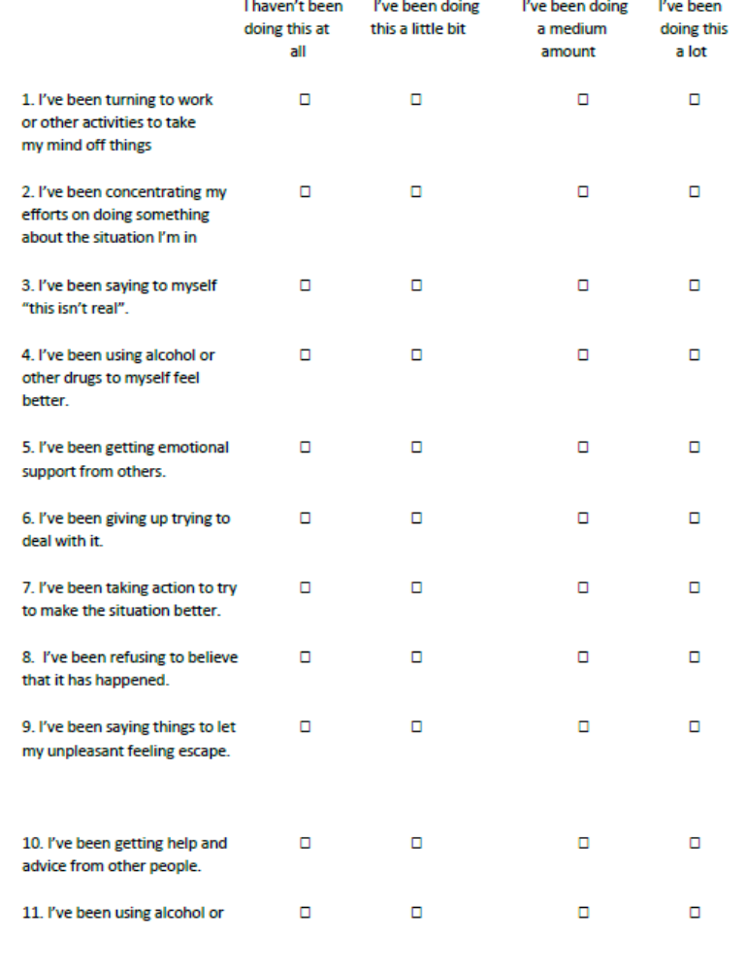


Slide 38
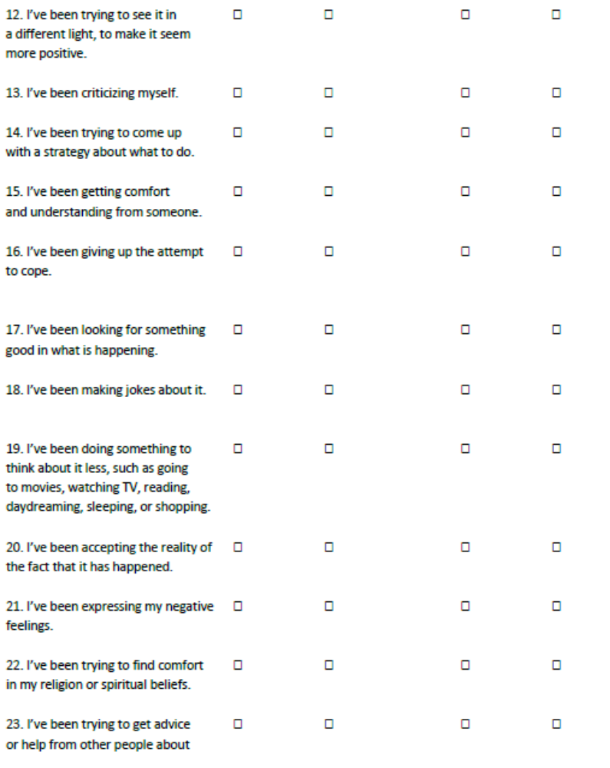


Slide 39
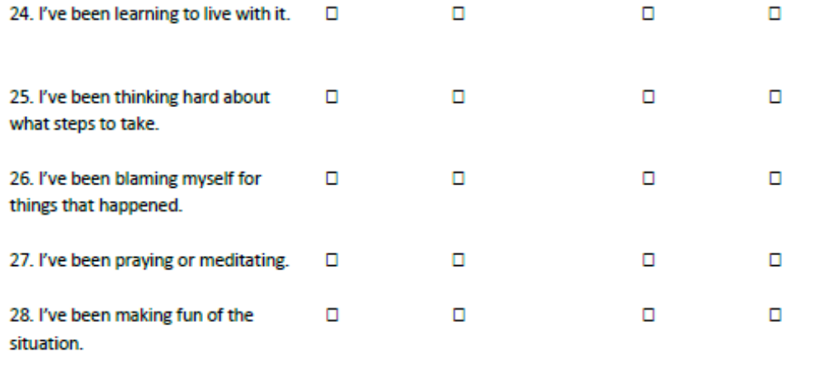


Slide 40
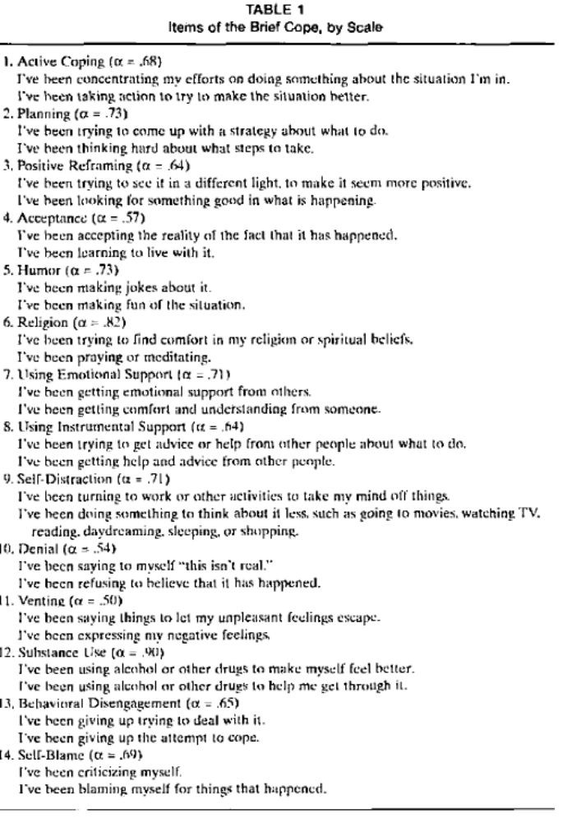
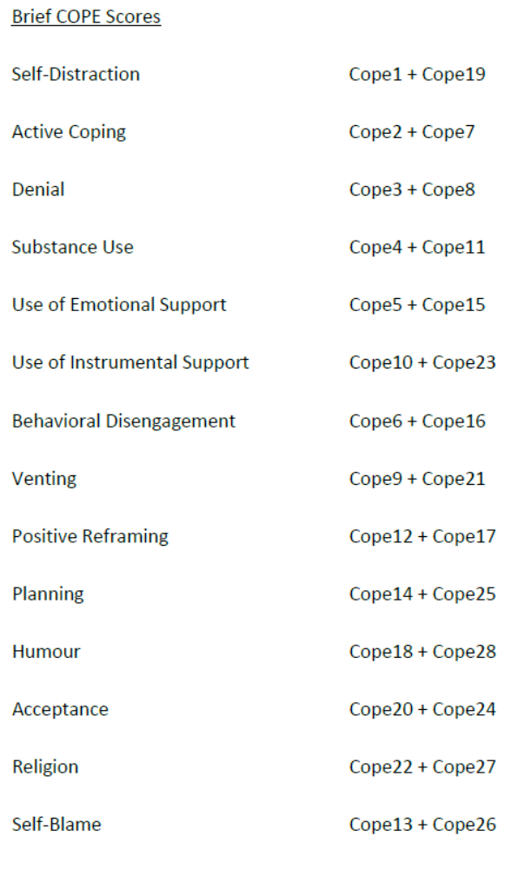

Slide 41
Gender, age and sociocultural differences in coping
Coping changes over the lifespan
  Coping in children depends on cognitive and language skills
  Adolescents – girls social support, self blame, boys distraction
  Middle-aged persons tend to use problem-focused coping whereas the elderly use more emotion-focused coping
Men report more problem-focused and women more emotion-focused coping
  But, men alcohol/drugs, exercise, avoid, women vent emotionally, seek support, avoid
  When balanced for income/SES etc…
  Higher incomes and educational level report using more problem-focused coping
    Praying/hoping vs acting

